Slide 1
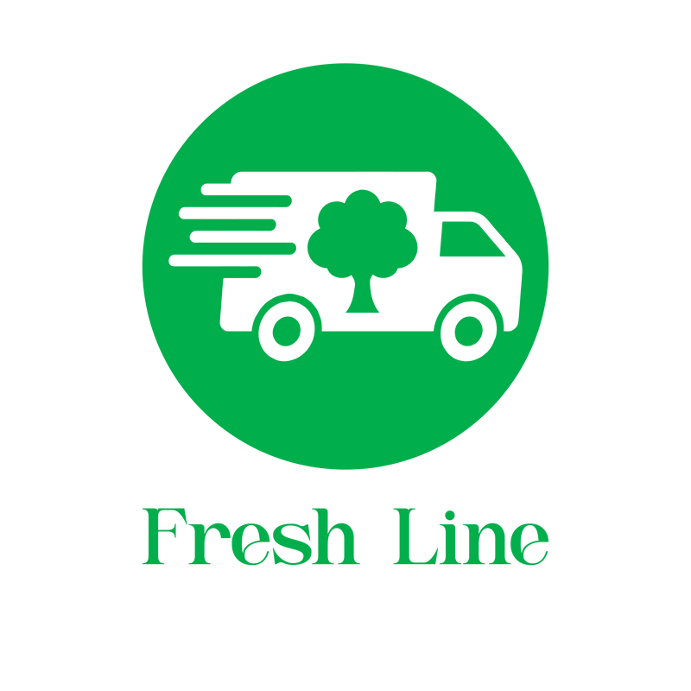


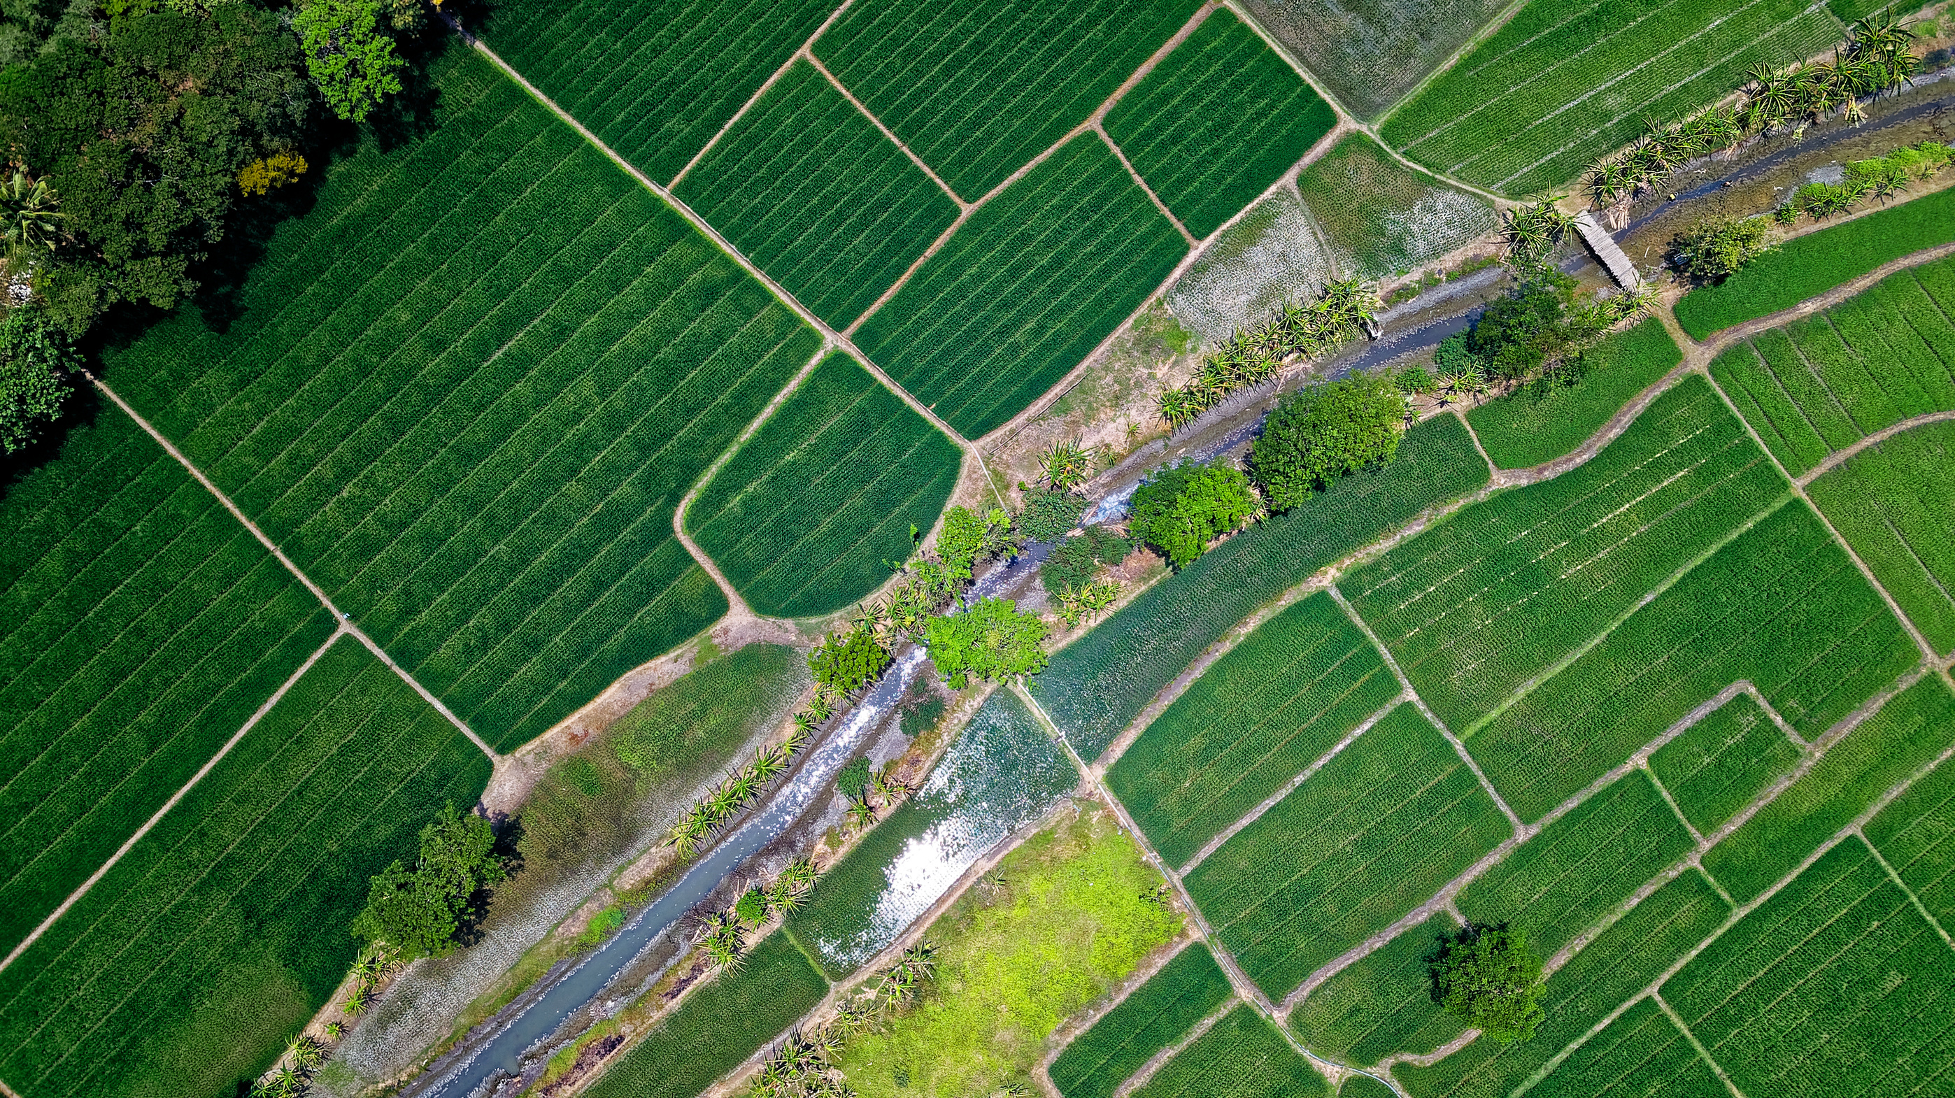
From Farm to Table - Freshness in Every Order

Slide 2
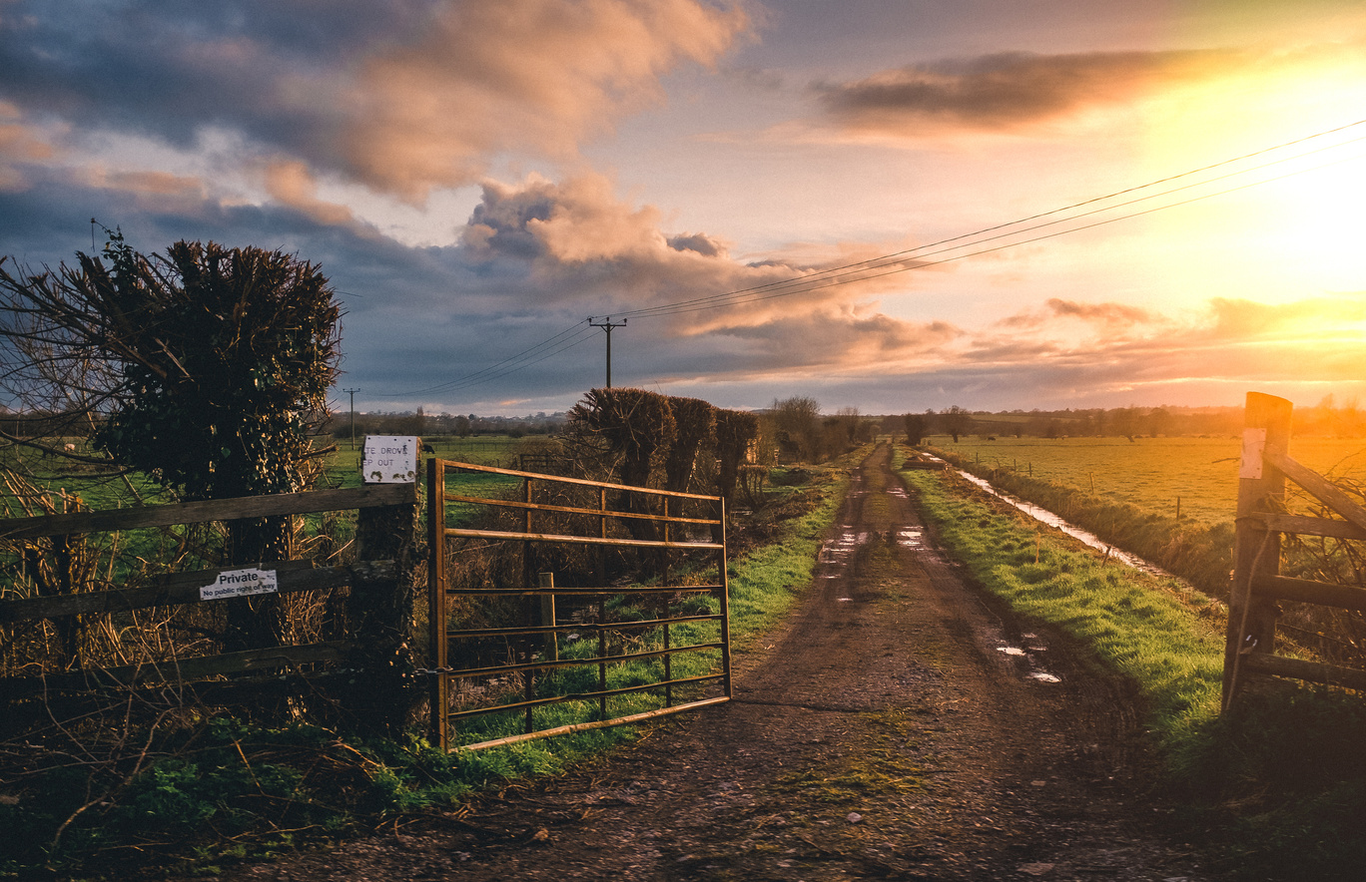

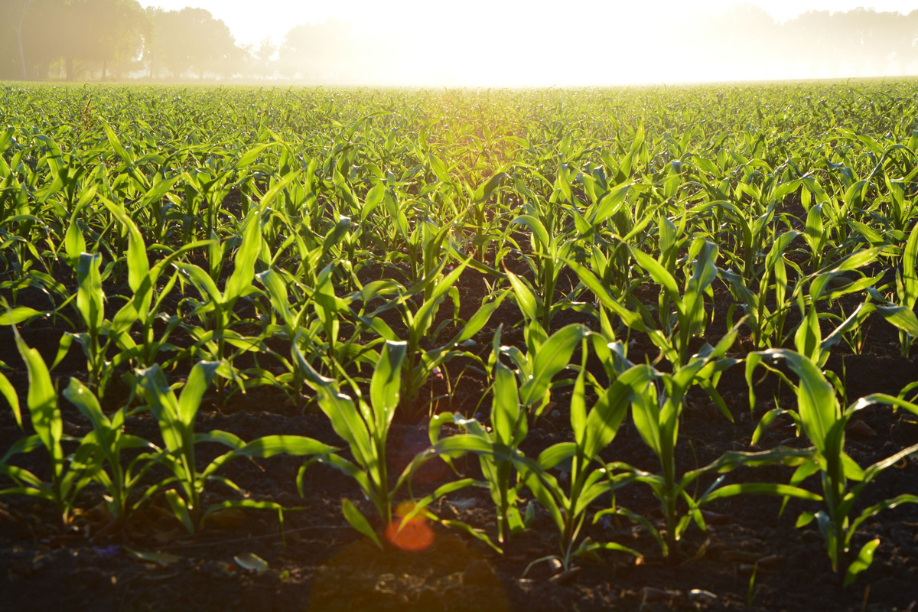
Every day,
millions of farmers grow food with love — yet up to 40% of their profit disappears before reaching your table.
Not because of lack of quality… but because of
Logistics inefficiency and invisibility.
Learn More

Slide 3
China built the fastest logistics empire in history.
Learn More

Slide 4

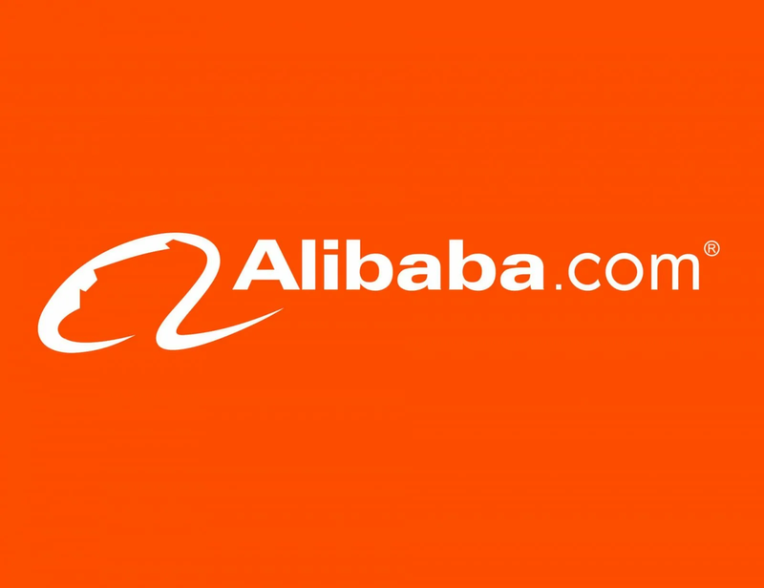
Understanding China’s Strength
We admire China’s
Logistics leadership
Cainiao’s AI warehouses,
Global e-commerce infrastructure — it’s a masterpiece of coordination.

Slide 5
But the next challenge is not speed -
Learn More

Slide 6
But the next challenge is not speed -
it’s sustainability, transparency, and trust.
Learn More

Slide 7
The world mastered speed, but not visibility.

Slide 8
For small producers — for the farmer, the supplier, the startup — global logistics is still a black box.

Slide 9
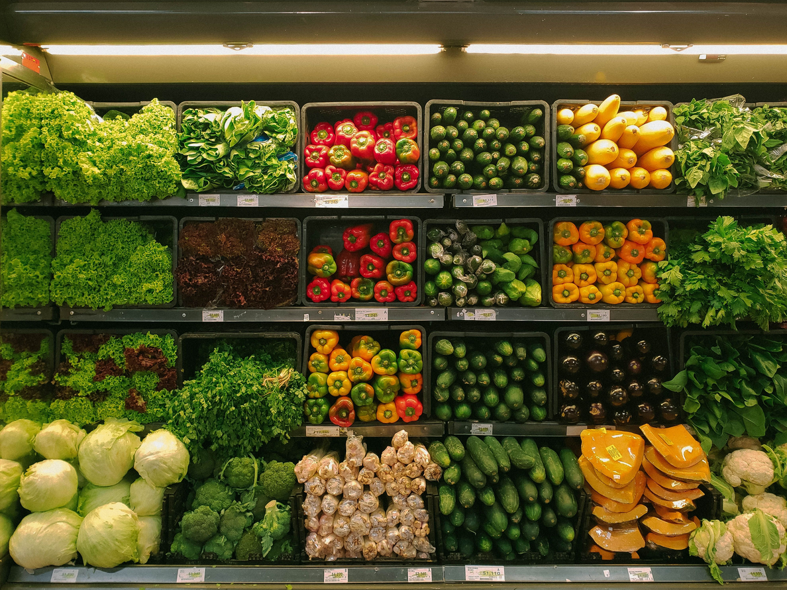


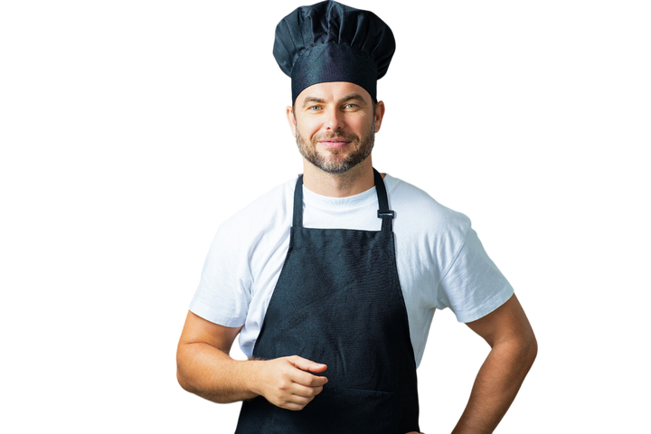
The Problem
Invisible Farmers, Fragmented Trust
>-30% waste
18-25% lose freshness
up to 40% of total produce may lose optimal quality
>-40% profit loss
Additional 10-15% freshness lost

Slide 10


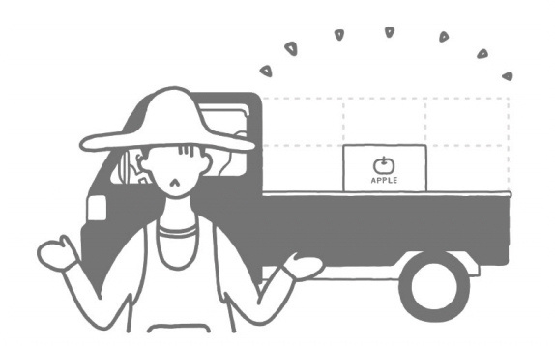
The Problem: Farmers
Fields in Crisis: The Farmer’s Burden
Difficulty distributing to smaller
restaurants
Cumbersome payment management
Hard time accustoming to client’s
needs
Delivering to multiple restaurants is
challenging for farmers as it involves
time-consuming tasks such as packing,
sorting, and managing logistics
Issuing invoices and arranging for
payment collection is cumbersome when
you have multiple restaurants to manage,
not to mention late payments.
It’s not easy for farmers to know
consumers’ demands & get feedback of
their products. It’s also hard for farmers
to find out consumers’ preference.

Slide 11


Our Vision
FreshLine Project
Fresh Line is a hybrid green marketplace — connecting farmers, suppliers, and consumers through transparent logistics and real-time tracking.
> It’s not just an e-commerce platform.
> It’s a smart logistics ecosystem —
combining marketplace + sustainability + live insight.

Slide 12


How It Works – 智能物流的心脏
Each farmer has a verified profile.
Each product has a traceable freshness index.
And every shipment runs through a logistics intelligence layer that shows:
> – where the product is,
> – how long it’s been stored,
> – and its environmental footprint.
We visualize the supply chain in real time —
simple for users, powerful for data.

Slide 13
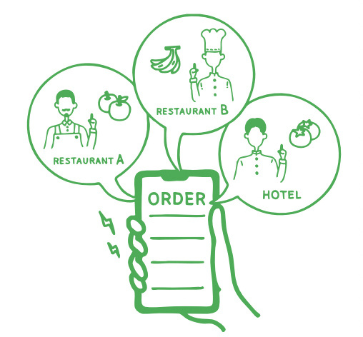
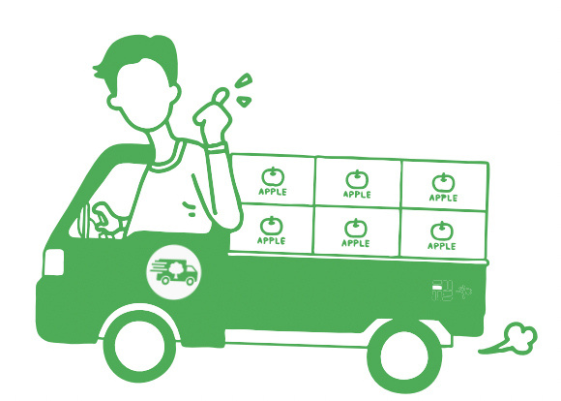
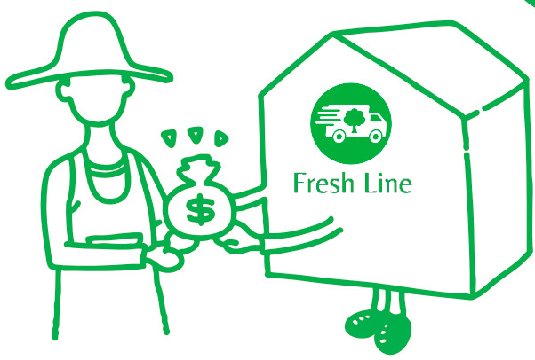
The Solution: Farmers
Fields to Fortune: Empowering farmers
Streamlined Logistics, Sorting &
Packing
We provide support in soliciting
customers for you
Flexible Pricing
Let us handle the bothersome tasks. You
only have to pack and send your
products to us!
Leave customer acquisition up to us
while you focus on your farm. Count on
us to actively bring in clients for your
business!
Set your own credit terms based on the
your harvest conditions!

Slide 14


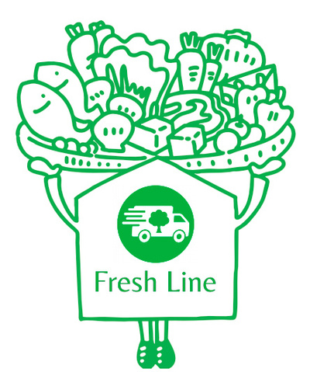
The Solution: HORECA
Plates to Prosperity : HORECA’s Fresh edge
Find products and place your order
easily
Reduced wastage, increased variety
Fresh & transparent
Our online platform provides you with a
catalogue of ingredients form various
different farmers and allows for online
placing order just like online shopping!
Not only do we not have an MOQ, you
can also find artisanal and imported
products on our platform!
Products are delivered within a day with
guaranteed quality and you can find all
product information on our platform.

Slide 15
Integrated Innovation – Constructive Disruption
Module | Description
Green Marketplace | Farmers directly connect with verified buyers
Logistics Dashboard | Unified transparency layer (AI + Blockchain ready)
Sustainability Engine | Carbon footprint scoring for every delivery
Instead of replacing China’s system —
we enhance it with an open, collaborative layer.
Our platform could integrate with **Cainiao, JD Logistics, or local networks to bring farmer visibility to the global supply chain.

Slide 16
Impact – 数据 speaks louder than words
By connecting real-time transparency with sustainability metrics,
we create measurable progress.
Metric | Result
Visibility | +30% more supply chain clarity
Refund disputes | –50% reduction
Carbon footprint | –20% per delivery
Farmer income | +25% average increase
“This is not just business.
It’s a model of global responsibility.”

Slide 17
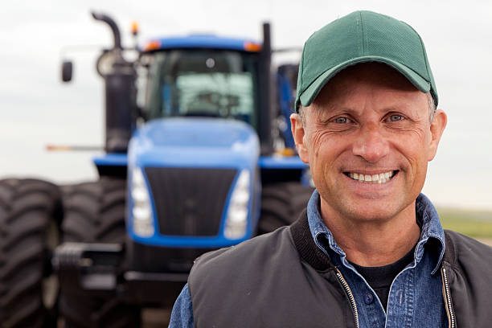
The Future
We believe the next evolution of logistics
> will not be measured only in speed —
> but in trust, sustainability, and human connection.

Slide 18








Logistics
Cold Precision Logistics — Premium Line

Slide 19
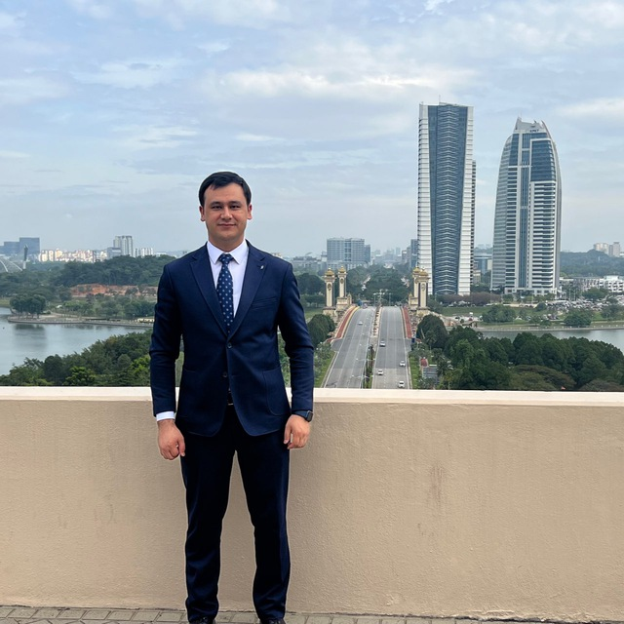
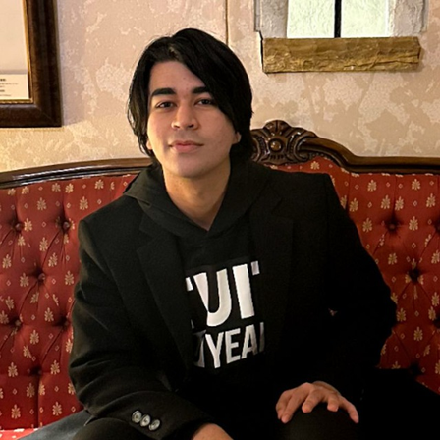


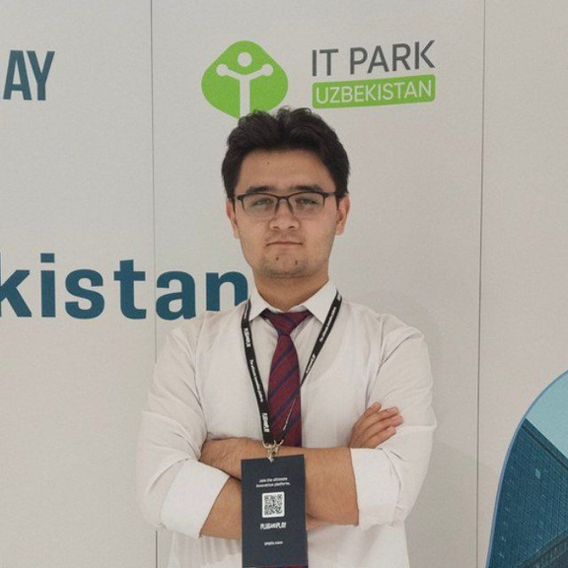
Main Team
Ibrohimbek Yusupov
Iskandar Shomuradov
Sabina Israilova
Boburjon Allayorov
Foziljon Ruzmamatov
Our mentor and Director of International Affairs from TUIT
Product Manager
Presenter
Programmer
Manager

Slide 20
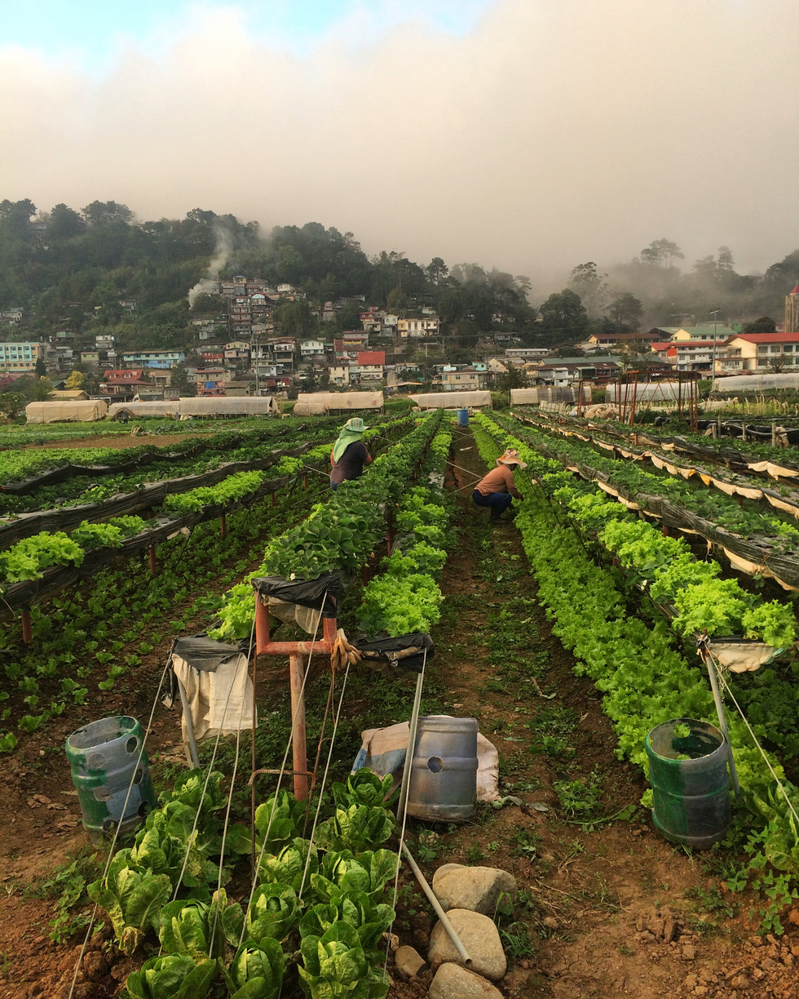
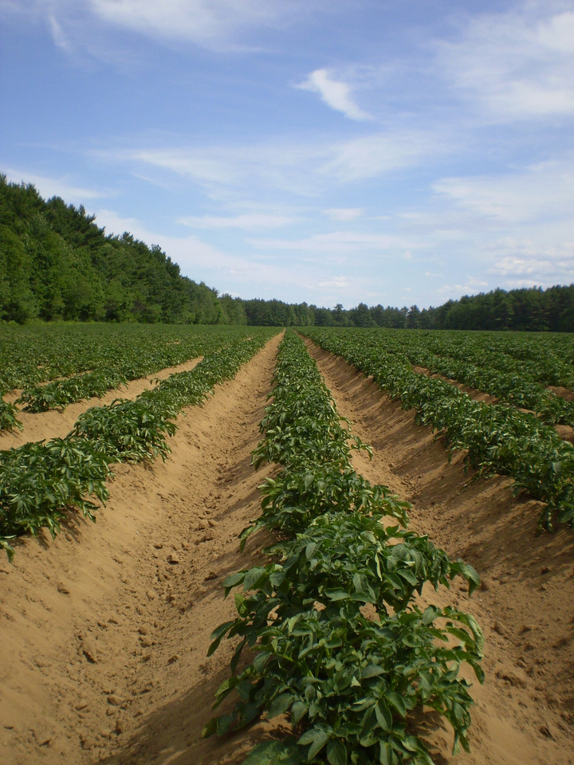



THANK YOU
+998908086383
HAMRAYEV-2000@MAIL.RU

